Slide 1
Introduction to Kubernetes for Developers
Philly.NET Code Camp 2024.1
Jason L. van Brackel
19 April 2024

Slide 2




CONTACT ME
Jason van Brackel
@JvB
@jasonvanbrackel
jasonvanbrackel

Slide 3
First Things First
We need a cluster! And grab a couple tools

Slide 4
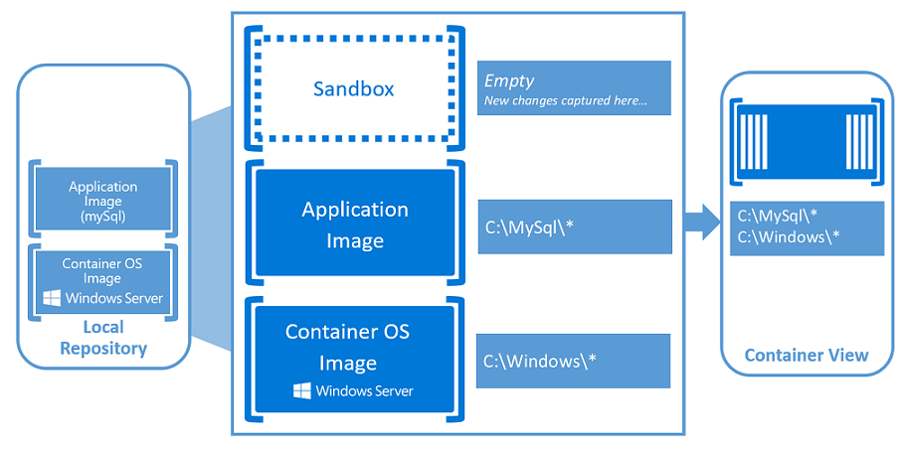
Container Fundamentals
Windows Containers - https://docs.microsoft.com/en-us/virtualization/windowscontainers/about/index

Slide 5
Containers are not VMs
VM
Containers
App A
App A₁
App B
Windows Server Guest OS
Windows Server Guest OS
Windows Server Guest OS
App A
App A₁
App A₂
App A₃
App B
App B₁
Docker
Hypervisor (Type 1)
Server (Host OS)
Server
Server

Slide 6
Containers are not VMs
VM
Containers
App A
App A₁
App B
App A
App A₁
App A₂
App A₃
App B
App B₁
Docker
App A
App A₁
App A₂
App A₃
App B
App B₁
Docker
App A
App A₁
App A₂
App A₃
App B
App B₁
Docker
Windows Server Guest OS
Windows Server Guest OS
Windows Server Guest OS
Windows Server (Host OS)
Windows Server (Host OS)
Windows Server (Host OS)
Hypervisor (Type 1)
Hypervisor (Type 1)
Server
Server

Slide 7
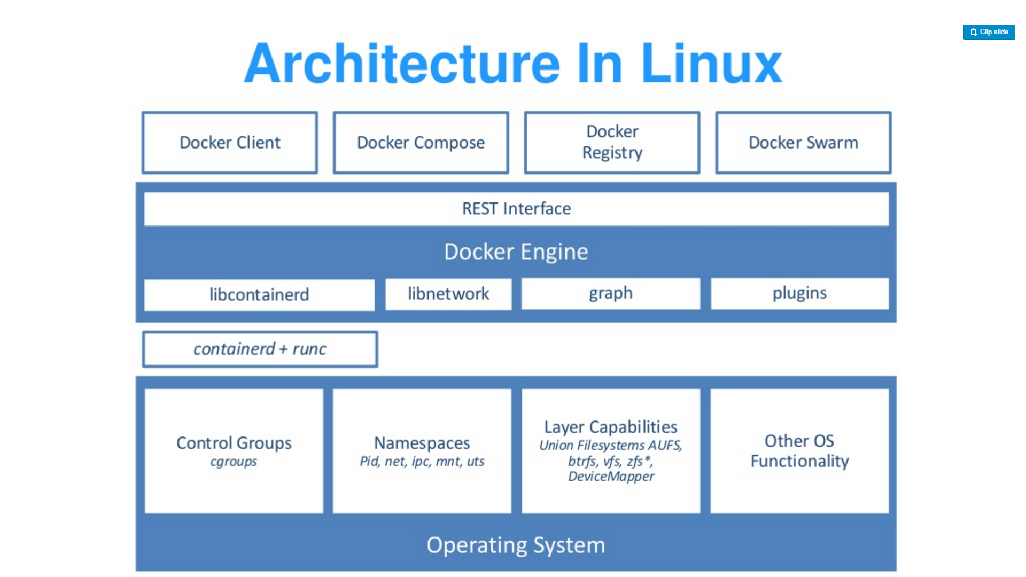
Source: “DockerCon 16: Windows Server & Docker - The Internals Behind Bringing Docker & Containers to Windows - Black Belt”

Slide 8
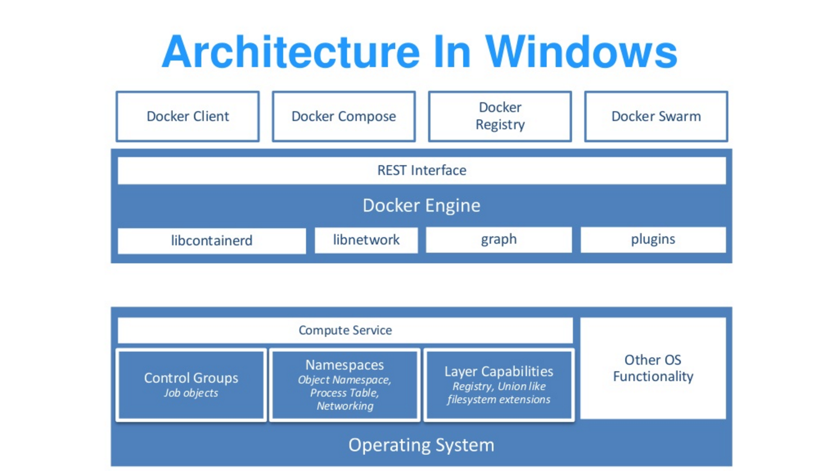
Source: “DockerCon 16: Windows Server & Docker - The Internals Behind Bringing Docker & Containers to Windows - Black Belt”

Slide 9
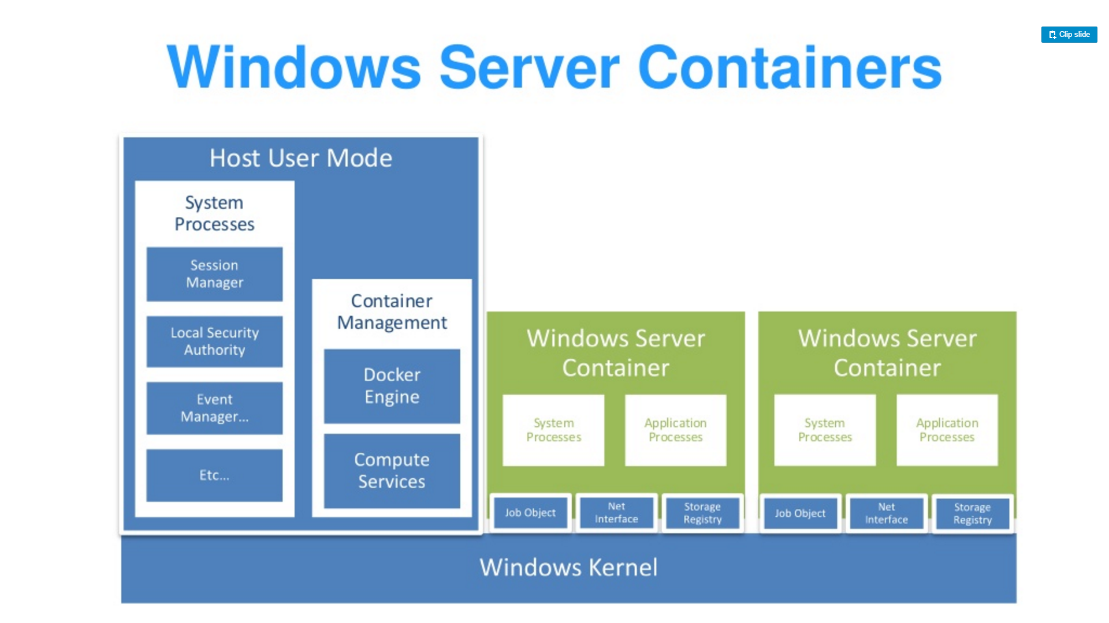
Source: “DockerCon 16: Windows Server & Docker - The Internals Behind Bringing Docker & Containers to Windows - Black Belt”

Slide 10
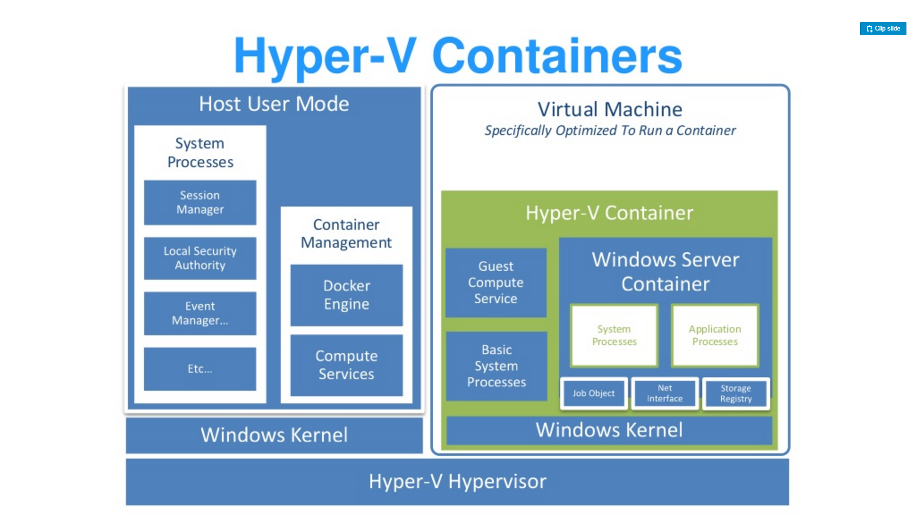
Source: “DockerCon 16: Windows Server & Docker - The Internals Behind Bringing Docker & Containers to Windows - Black Belt”

Slide 11
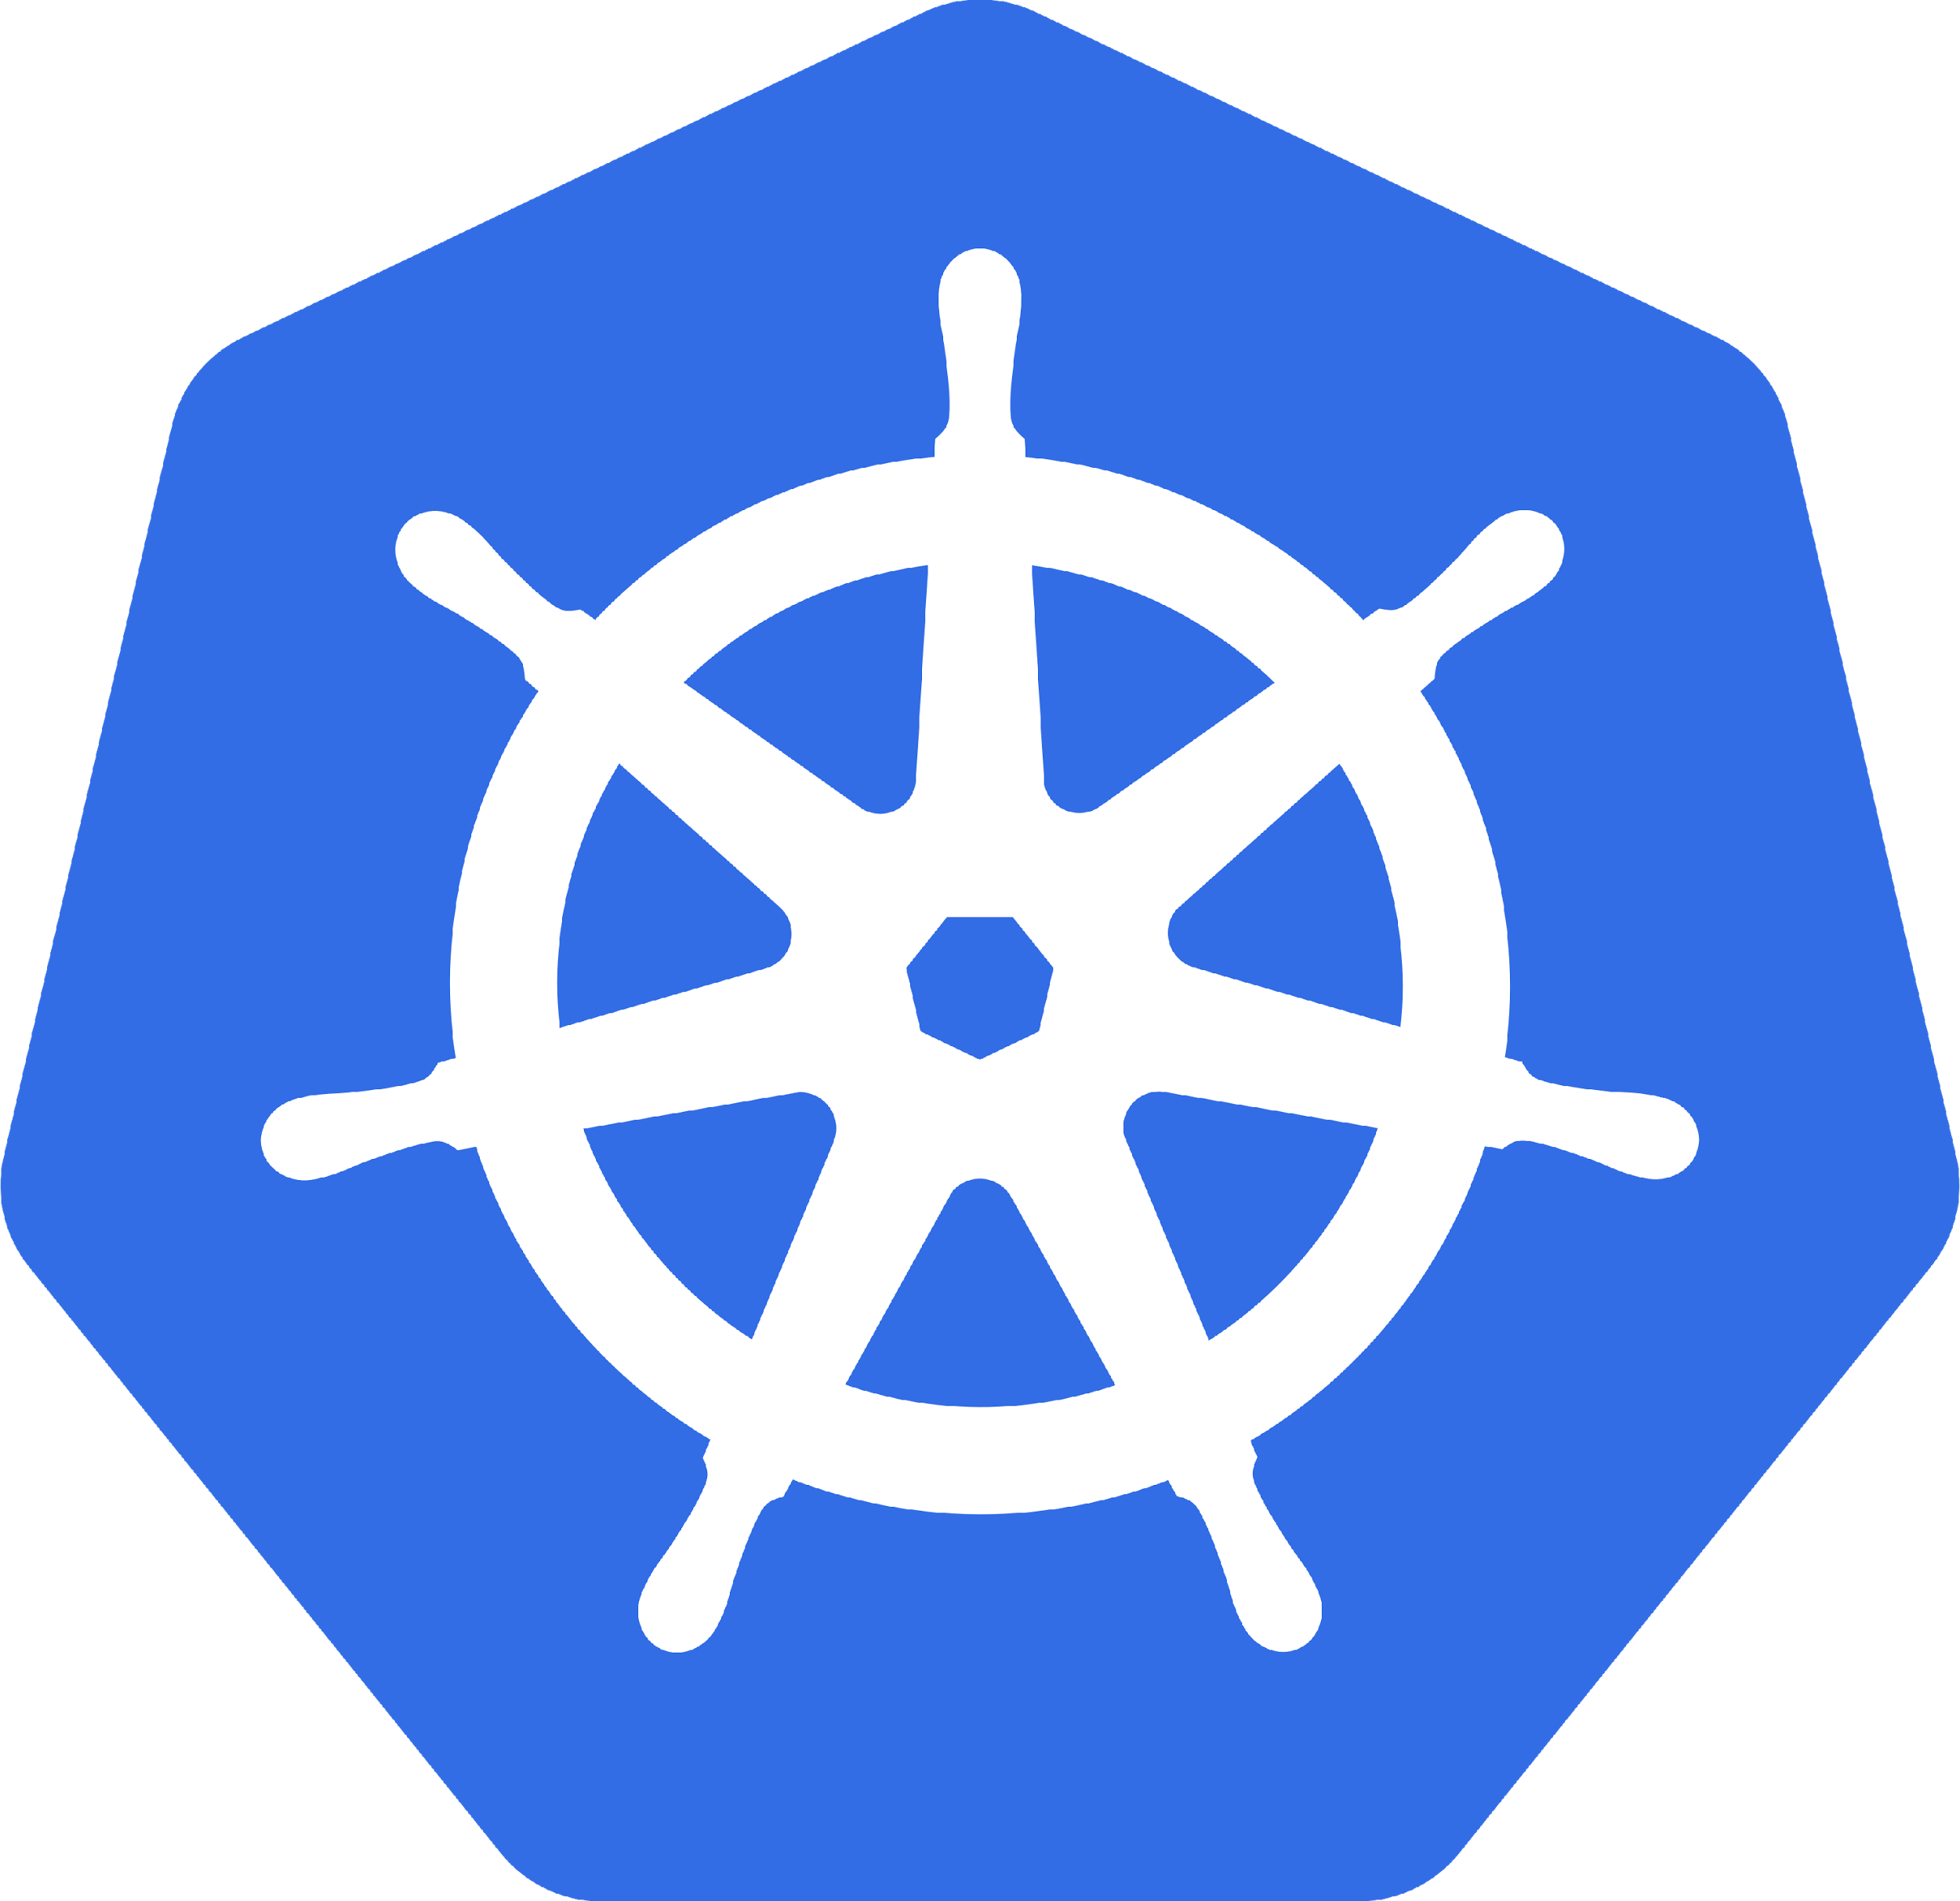
What is Kubernetes
Orchestrates
Containers

Slide 12
What is Kubernetes
Orchestrates
Containers
Storage
Infrastructure

Slide 13
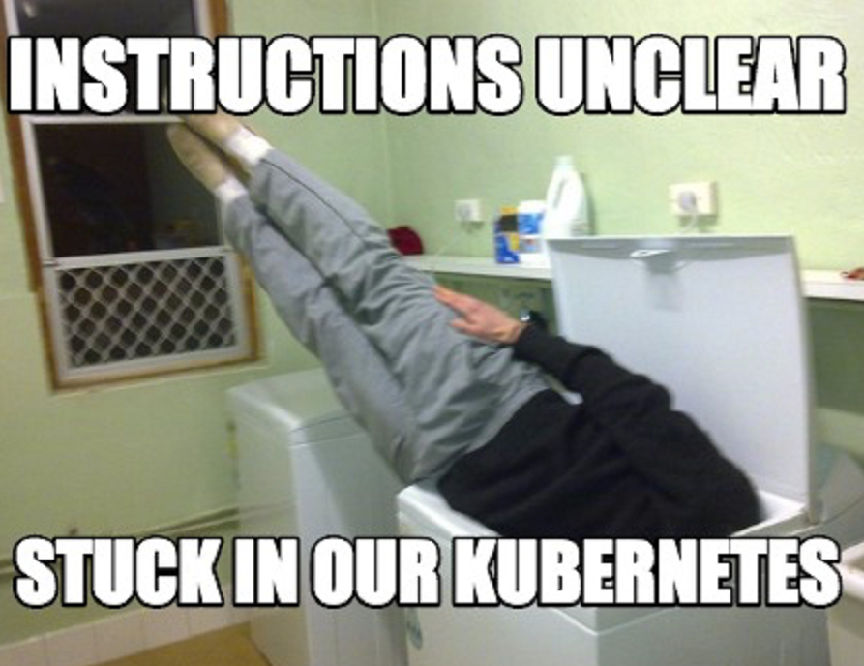
It Is Complex
Scale
Kubernetes Reference API
What is Kubernetes Physically Speaking?

Slide 14
Why Should I care?
Developers
Operators
It’s Everwhere

Slide 15
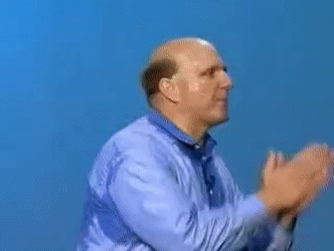
Why Should Developers care?
Containerized Applications
Breaking the Monolith
It’s the Substrate

Slide 16
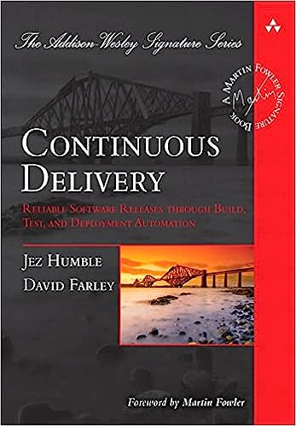
Why Should Developers care?
12 Factor Methodology
Microservice Architecture

Slide 17
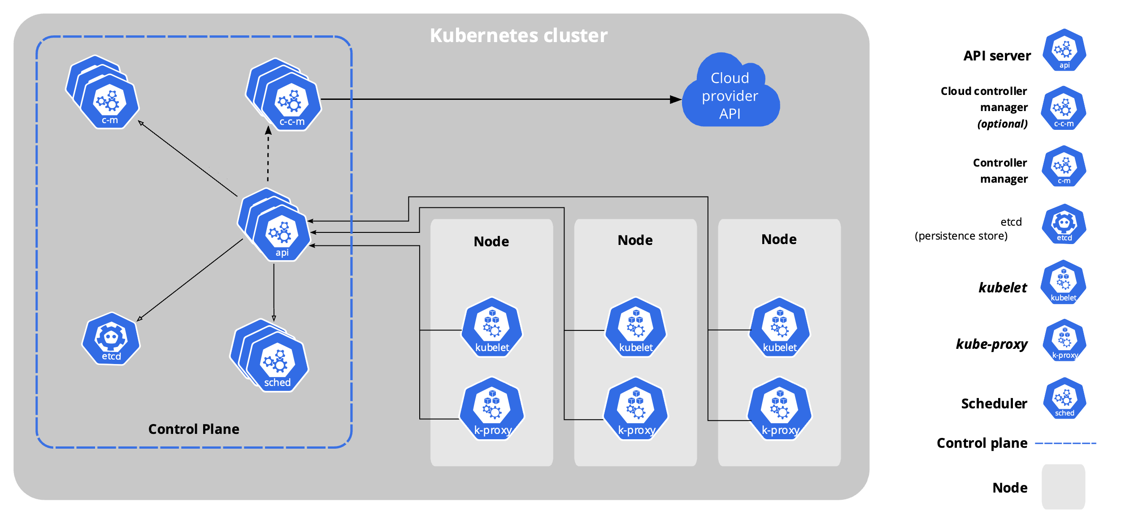
https://kubernetes.io/docs/concepts/architecture/cloud-controller/#design

Slide 18
Don’t run kubernetes

Slide 19
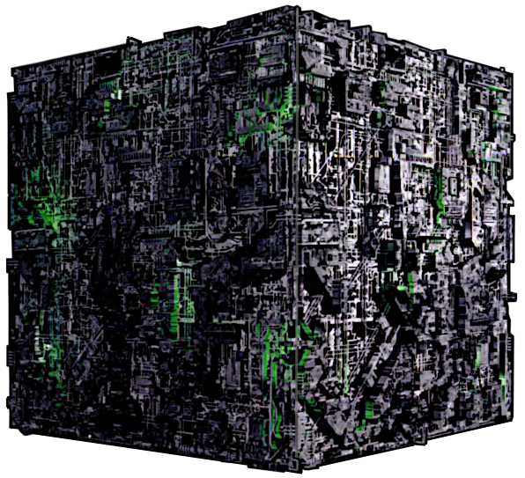
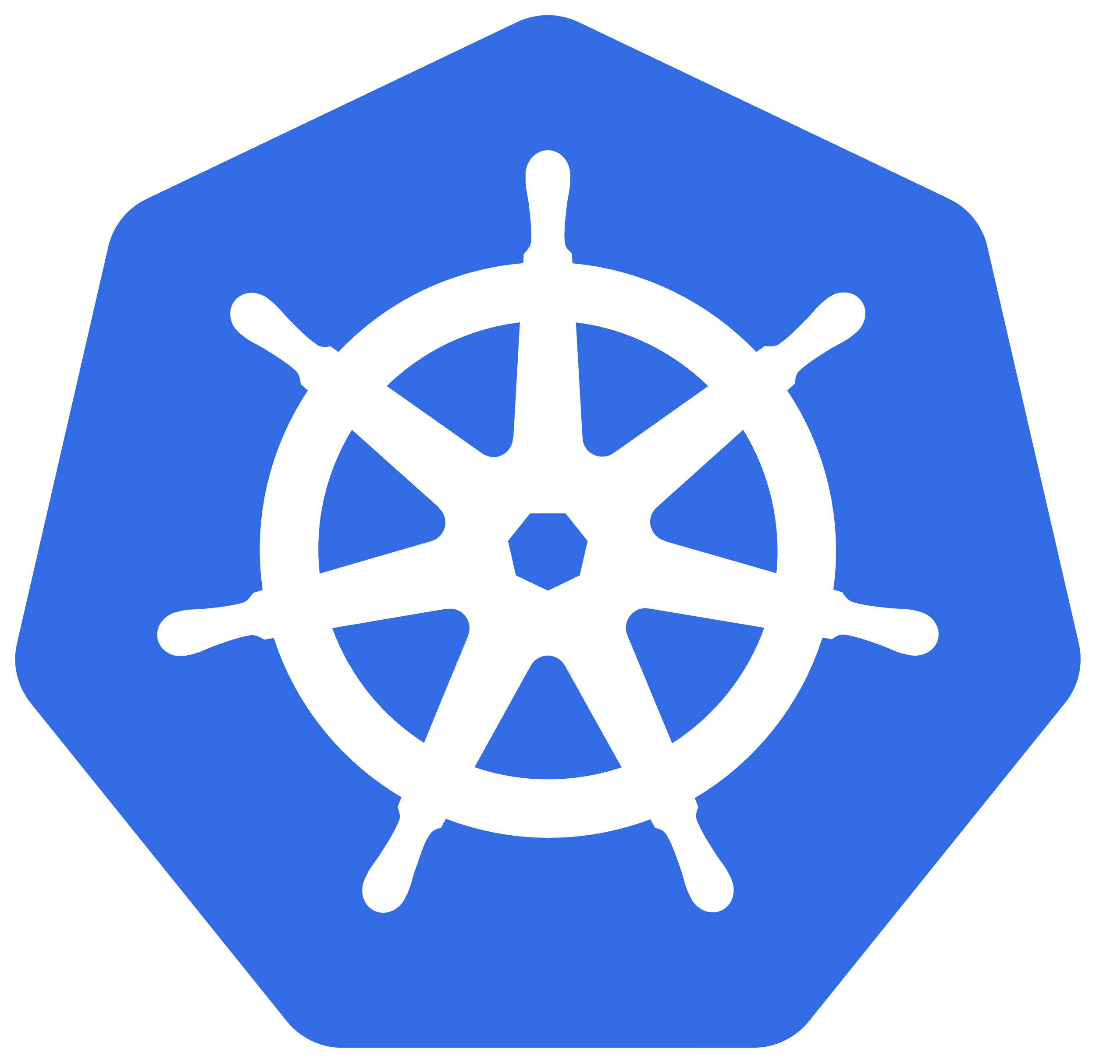
Ω
Large-scale cluster management at Google with Borg - https://research.google/pubs/pub43438/
Borg, Omega, and Kubernetes - https://research.google/pubs/pub44843/

Slide 20
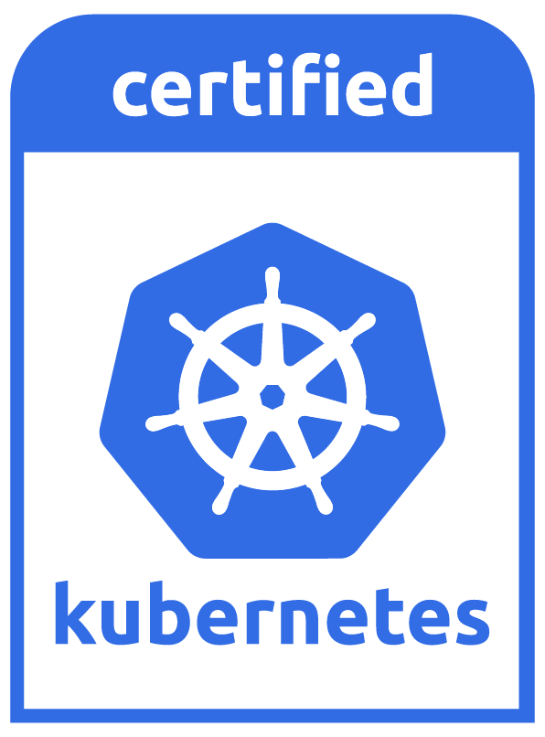
What does it do?
Automated rollouts and rollbacks
Service discovery and load balancing
Service Topology
Storage orchestration
Secret and configuration management
Automatic bin packing
Batch execution
IPv4/IPv6 dual-stack
Horizontal scaling
Self-healing

Slide 21

K8s Is Hard!
Kubernetes

Slide 22

K8s Is Hard!
Kubernetes

Slide 23



K8s Is Hard!
Kubernetes
Underlying CRI

Slide 24
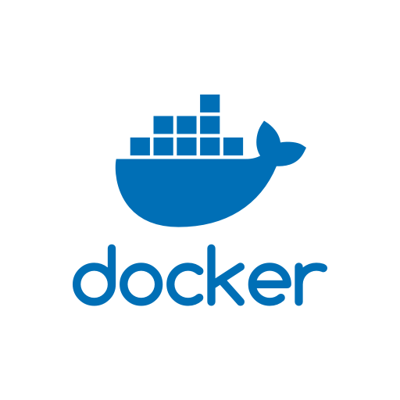
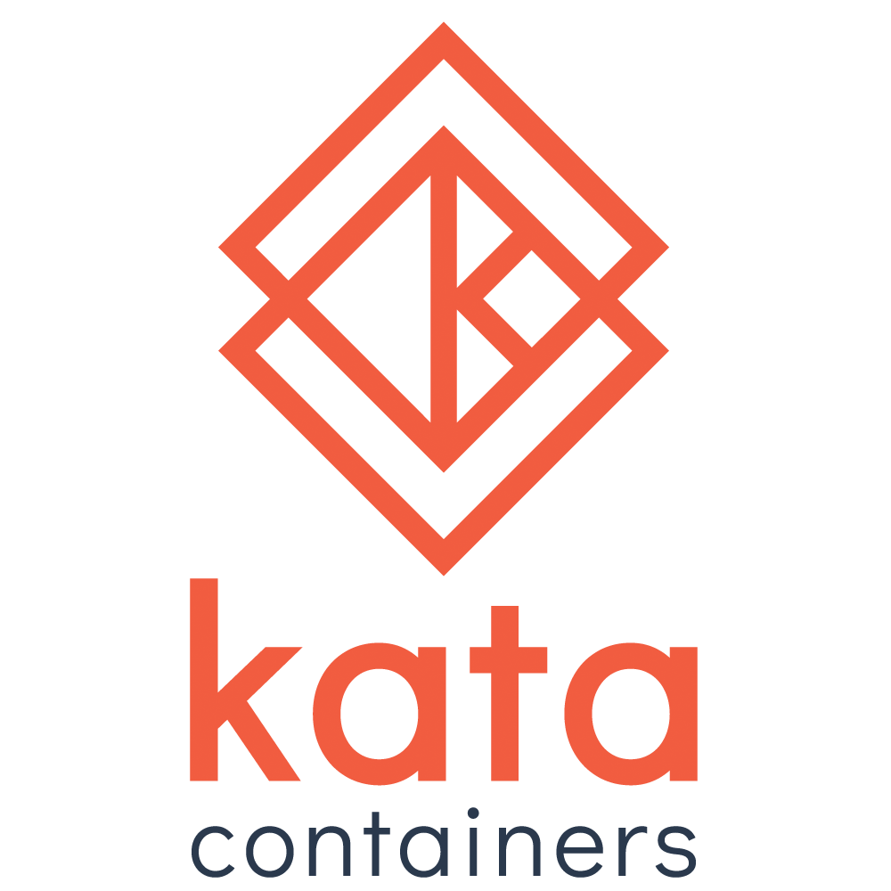

K8s Is Hard!
Kubernetes
Underlying CRI

Slide 25




K8s Is Hard!
Kubernetes
Underlying CRI
Underlying CNI

Slide 26
What does it do?
Automated rollouts and rollbacks
Service discovery and load balancing
Service Topology
Storage orchestration
Secret and configuration management
Automatic bin packing
Batch execution
IPv4/IPv6 dual-stack
Horizontal scaling
Self-healing

Slide 27
K8s IS Hard!
Application Migration
API Gateway / Service Mesh
Logging
Observability
Persistence
CI/CD
Compliance
Container Registries

Slide 28
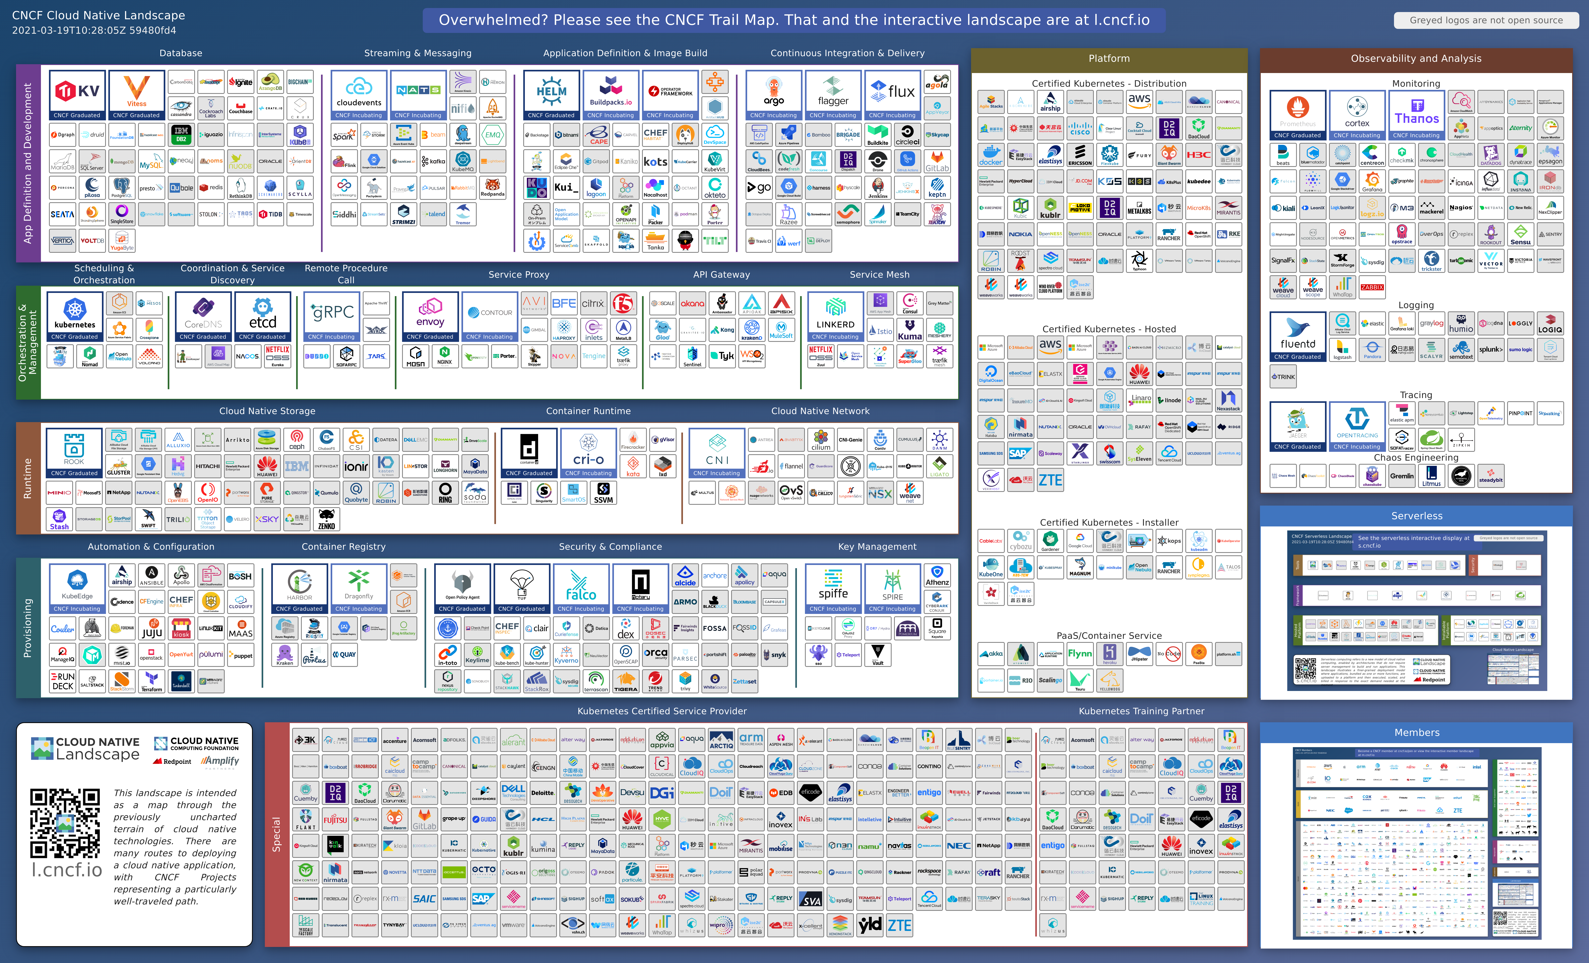

Slide 29
Application Migration

Slide 30
API Gateway & Service Mesh

Slide 31
Logging

Slide 32
Observability

Slide 33
Persistence and Storage

Slide 34
CI/CD

Slide 35
Compliance

Slide 36
Container Registries

Slide 37
Let’s Take a Look At a Couple
Rancher Kubernetes - CNCF Cloud Native Interactive Landscape
k3s - CNCF Cloud Native Interactive Landscape
Red Hat OpenShift - CNCF Cloud Native Interactive Landscape

Slide 38
When should Use K8s?
You’re Running Massive Scale
You Write Large Scale Distributed Microservices
Your Company Isn’t Giving You a Choice

Slide 39
When Should I Run K8s?
Airgap is Required
Hybrid Cloud Scenarios
Regulatory Need
You’re Experienced
Your Company Isn’t Giving You a Choice

Slide 40
Which Distribution Should I Choose?
Strong User Base
Commercial Support
CNCF Certified Kubernetes
Open Source vs. Open Core

Slide 41



Which Distribution Should I Choose?
https://k3s.io
https://docs.rke2.io/
https://www.openshift.com/

Slide 42

Which Distribution Should I Choose?
https://www.rancher.com/
https://www.openshift.com/

Slide 43
Which Service Should I Choose?
Open Source?
Existing Contracts
Existing Relationships
Regulatory Concerns
SLAs
CNCF Certified Kubernetes

Slide 44
What is generally not an issue
Cost
Uptime
Speed
Extra Features
Upgrades

Slide 45
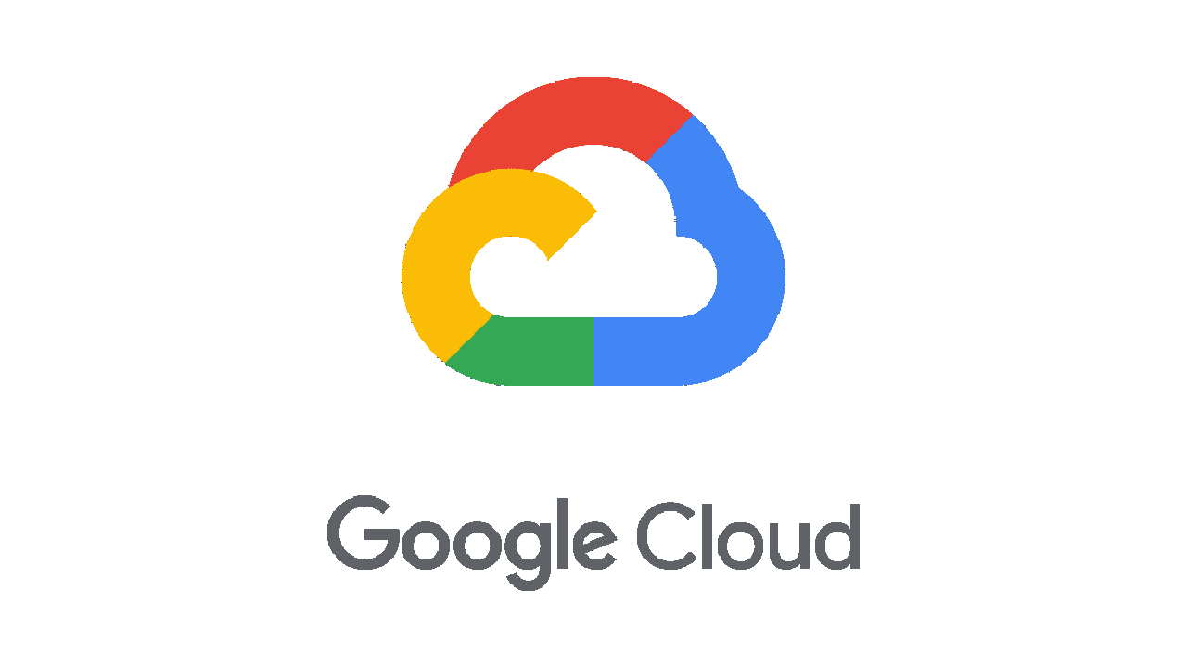




Personal Ranking
Major Cloud Providers
Smaller Cloud Providers

Slide 46
Kubernetes Concepts

Slide 47
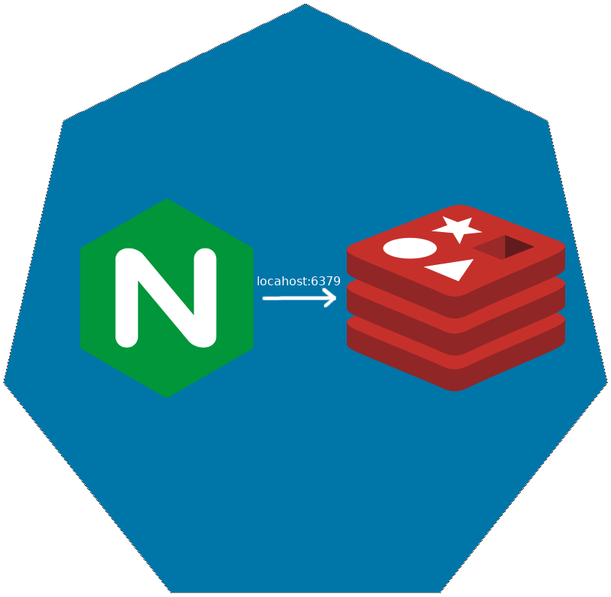
Pod
Co-scheduled
Shared Network Namespace
Shared Files System

Slide 48

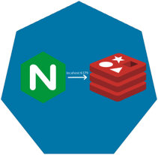
ReplicaSet

Slide 49

ReplicaSet

Slide 50
ReplicaSet

Slide 51
Deployments

Slide 52
Deployments

Slide 53
Deployments

Slide 54
Deployments

Slide 55
Deployments

Slide 56
Services
Define a DNS entry that can be used to refer to a group of pods
Provide a consistent endpoint for the group of pods
Different types: nodePort, clusterIP, loadbalancer
#rancherk8s

Slide 57


Services (Node Port)
192.168.0.[1-3]:32000

Slide 58
Services (Load Balancer)
Public IP:80

Slide 59
Config Maps & Secrets
Allow storing of arbitrary configuration values and files
Exposed in pods as either environment variables or as local storage
Decoupled storage of configuration from pod spec
#rancherk8s

Slide 60
Config Maps & Secrets
apiVersion: v1
kind: ConfigMap
metadata:
name: dev-config
namespace: default
data:
Item1: dev-stuff
Item2: more dev stuff
apiVersion: v1
kind: ConfigMap
metadata:
name: qa-config
namespace: default
data:
Item1: qa-stuff
Item2: more qa stuff
apiVersion: v1
kind: ConfigMap
metadata:
name: prod-config
namespace: default
data:
Item1: prod-stuff
Item2: more prod stuff

Slide 61
Ingresses
Define how traffic outside the cluster is routed to inside the cluster
Used to expose Kubernetes services to the world
Route traffic to internal services based on factors such as host and path
Ingress is usually implemented by a load balancer (Nginx, HAProxy, AWS ELB, etc…)
#rancherk8s

Slide 62

Ingresses
Ingress Controller
https://my-nginx-app.cluster.com https://cluster.com/my-nginx-app

Slide 63
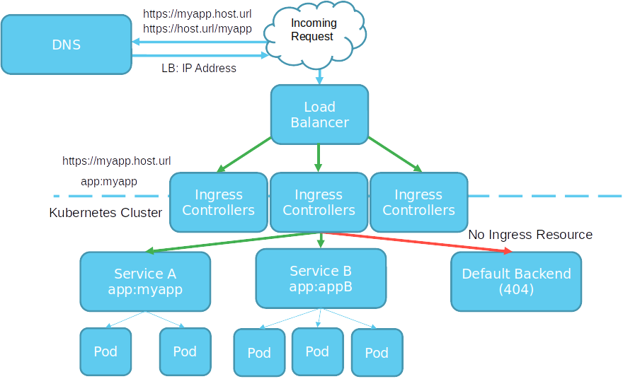

Slide 64
Tools
Running Kubernetes Locally
Running Kubernetes In The Cloud
Dealing with Scale

Slide 65
Running Kubernetes Locally
K3s
K3d
Rancher
Docker
Kind
KWOK

Slide 66
Running Kubernetes In the Cloud
AKS
EKS
GKE
Digital Ocean
Linode

Slide 67
Dealing with Scale
Find a framework you like
ELK
PLG
Don’t Over Alert

Slide 68
Packaging and Supply Chain Security
Chainguard
Zarf

Slide 69
Application Deployment
Helm
Kustomize
Zarf

Slide 70
Power Tools
K9s
Azure Draft
Dive

Slide 71
Understanding Storage in Kubernetes

Slide 72
Agenda
Storage APIs in Kubernetes
Volumes
EmptyDir
Host
Files
Config Maps
Secrets
Persistent Volumes
Provisioning
Static
Dynamic
Usage
Storage Options
Cloud
On-Premises
CSI

Slide 73
Storage APIs in Kubernetes
Configuration
ConfigMap
Secret
Storage
Volume
VolumeMount
PersistentVolume
PersistentVolumeClaim
StorageClass
VolumeAttachment

Slide 74
Volume
Solves Two Problems
Container Death
File Sharing
Lifetime of the Pod that encloses it.

Slide 75
Volume – Volume Types
awsElasticBlockStore
azureDisk
azureFile
cephfs
configMap
csi
downwardAPI
emptyDir
fc (fibre channel)
flocker
gcePersistentDisk
gitRepo (deprecated)
glusterfs
hostPath
iscsi
local
nfs
persistentVolumeClaim
projected
portworxVolume
quobyte
rbd
scaleIO
secret
storageos
vsphereVolume

Slide 76
Volume – Volume Types
Ephemeral Volumes
API Objects
Mounted Host Files & Directories
External Storage
Life of underlying files varies
Read the Docs

Slide 77
Volume – Volume Types
In-tree
Out-of-tree
FlexVolume
CSI

Slide 78
Volume – Volume Types
In-tree
Out-of-tree
FlexVolume
CSI
Linked, Compiled build and Shipped with Kubernetes

Slide 79
Volume – Volume Types
In-tree
Out-of-tree
FlexVolume
CSI
Requires Access to the Root Filesystem on control plane and worker nodes
Difficult to Deploy
External Dependencies

Slide 80
Volume – Volume Types
In-tree
Out-of-tree
FlexVolume
CSI
Standardized Mechanism
Side-cars provided to connect CSI drivers with Kubernetes
Alpha in 1.9, Beta since 1.10

Slide 81
Example 1
EmptyDir (Ephemeral)
ConfigMap (API Object)
HostDir (Mounted Host File)
NFS Share (External Storage)

Slide 82
Persistent Volumes
Represent distinct storage provisioned by an administrator (static) or Provisioner (dynamic)
Lifecycle independent of Pods

Slide 83
Persistent Volume – Volume Types
GCEPersistentDisk
AWSElasticBlockStore
AzureFile
AzureDisk
FC (Fibre Channel)
Flexvolume
Flocker
NFS
iSCSI
RBD (Ceph Block Device)
CephFS
Cinder (OpenStack block storage)
Glusterfs
VsphereVolume
Quobyte Volumes
HostPath (Single node testing only – local storage is not supported in any way and WILL NOT WORK in a multi-node cluster)
Portworx Volumes
ScaleIO Volumes
StorageOS

Slide 84
Persistent Volume – Volume Types
Some can be resized (beta)
Mount Options Vary
Read the Docs

Slide 85
Persistent Volume – Life cycle
Available
Bound
Released
Failed
A free PV that is not bound to a claim

Slide 86
Persistent Volume – Life cycle
Available
Bound
Released
Failed
The PV is bound to a PVC.

Slide 87
Persistent Volume – Life cycle
Available
Bound
Released
Failed
The claim has been deleted, but the PV is not yet reclaimed by the cluster.

Slide 88
Persistent Volume – Life cycle
Available
Bound
Released
Failed
Automatic reclamation has failed.

Slide 89
Persistent Volume – Reclaim Policy
Retain
Recycle
Delete
Manual reclamation of resources.

Slide 90
Persistent Volume – Reclaim Policy
Retain
Recycle
Delete
Deprecated – Largely unsupported. Don’t use it.

Slide 91
Persistent Volume – Reclaim Policy
Retain
Recycle
Delete
Underlying storage mechanism is deleted.

Slide 92
Storage Class
Gives an administrator the ability to create different storage offerings.
Can be attached to statically provisioned PVs or trigger the dynamic provisioning of PVs.

Slide 93
Storage Class – Internal Provisioners
AWSElasticBlockStore
AzureFile
AzureDisk
Cinder
Flocker
GCEPersistentDisk
GlusterFS
Quobyte
RBD
VsphereVolume
PortworxVolume
ScaleIO
StorageOS

Slide 94
Storage Class – External Provisioners
AWS – EFS
Ceph
Digital Ocean
Flex
Gluster
iSCSI
local-volume
NFS
NFS-Client
OpenEBS
https://github.com/kubernetes-incubator/external-storage

Slide 95
Example 2
Storage Class
Statically Provisioned
Dynamically Provisioned Storage

Slide 96
The Kitchen Sink
https://landscape.cncf.io/

Slide 97
ANY QUESTIONS?

Slide 98
CONTACT ME
Jason van Brackel
@JvB
@jasonvanbrackel
jasonvanbrackel

